Slide 1
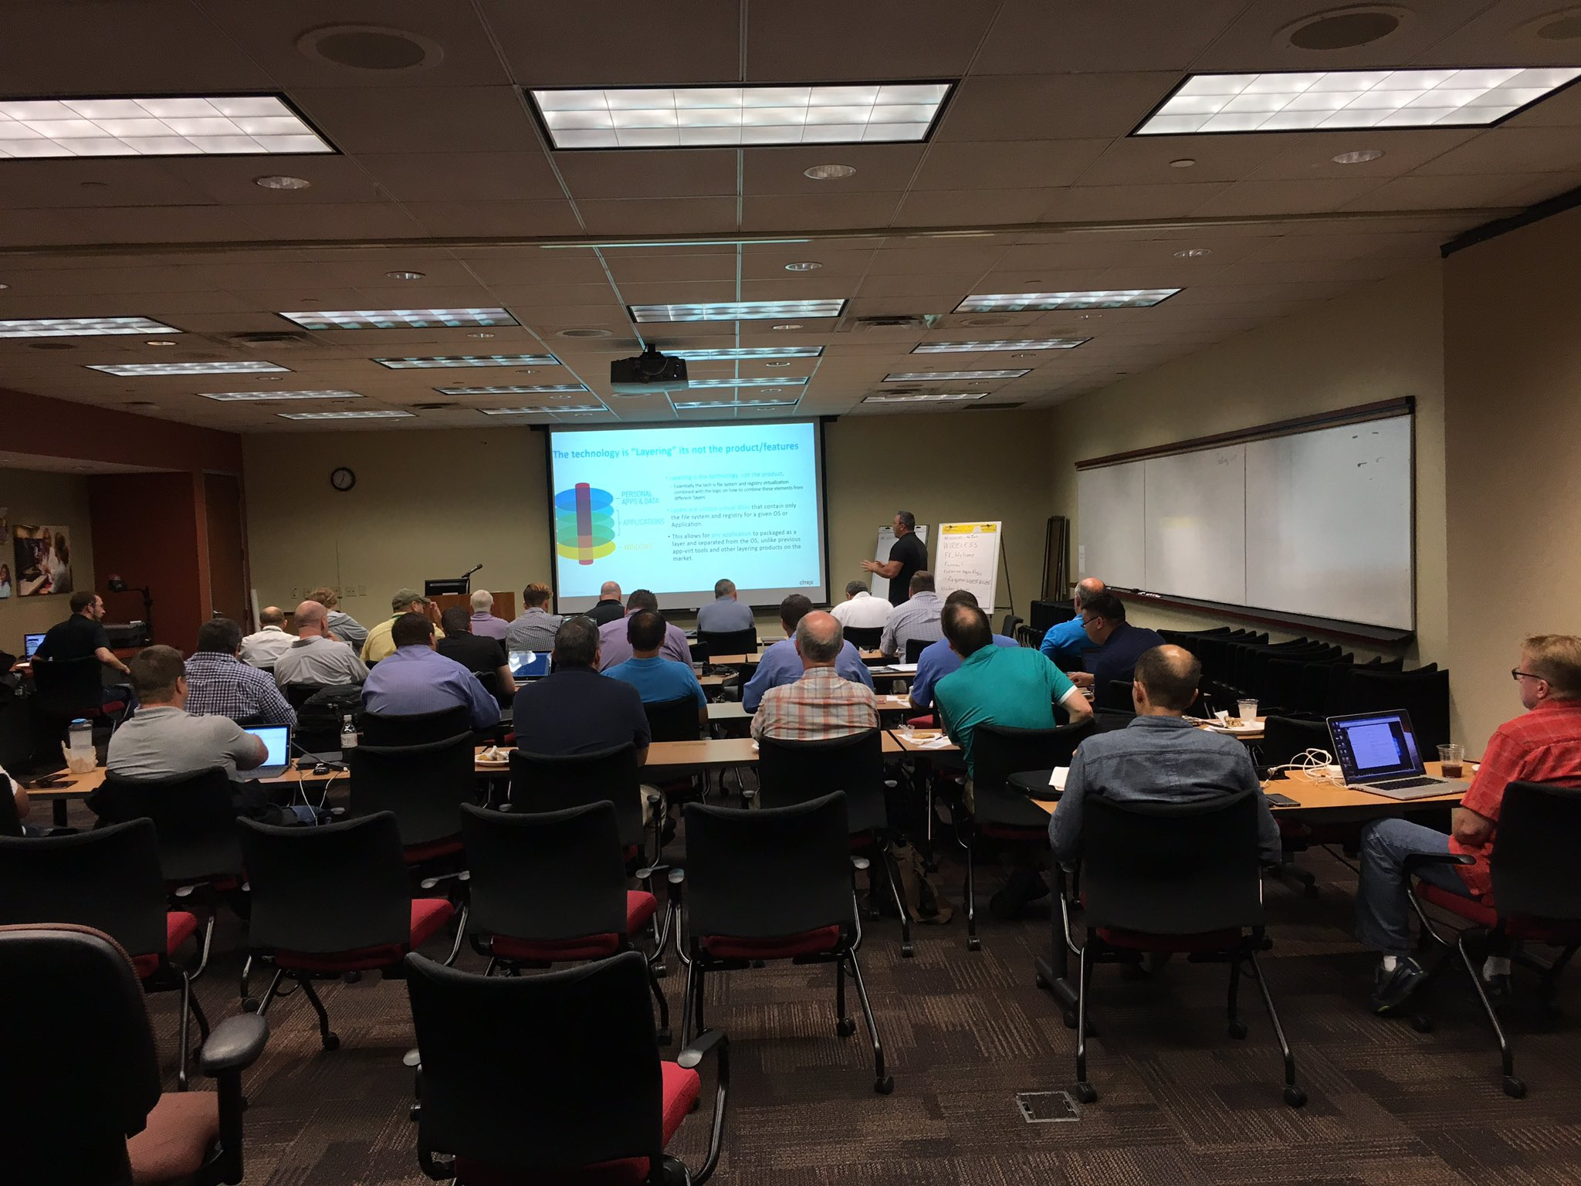

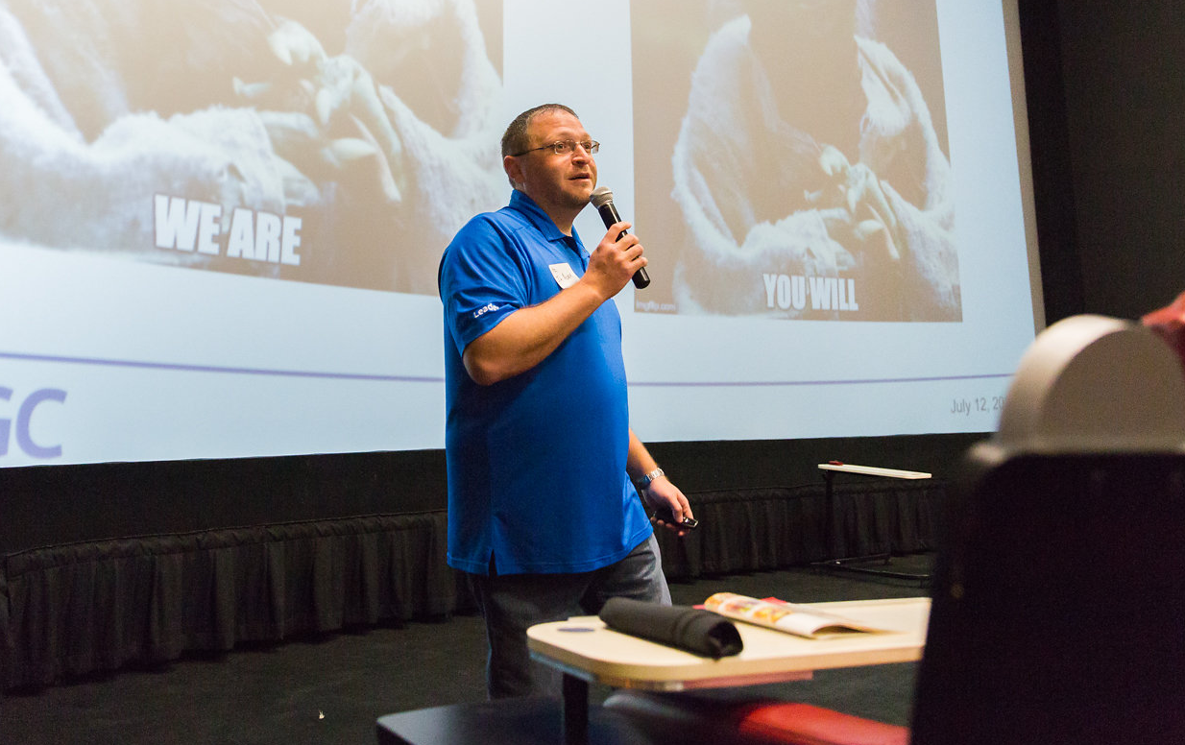
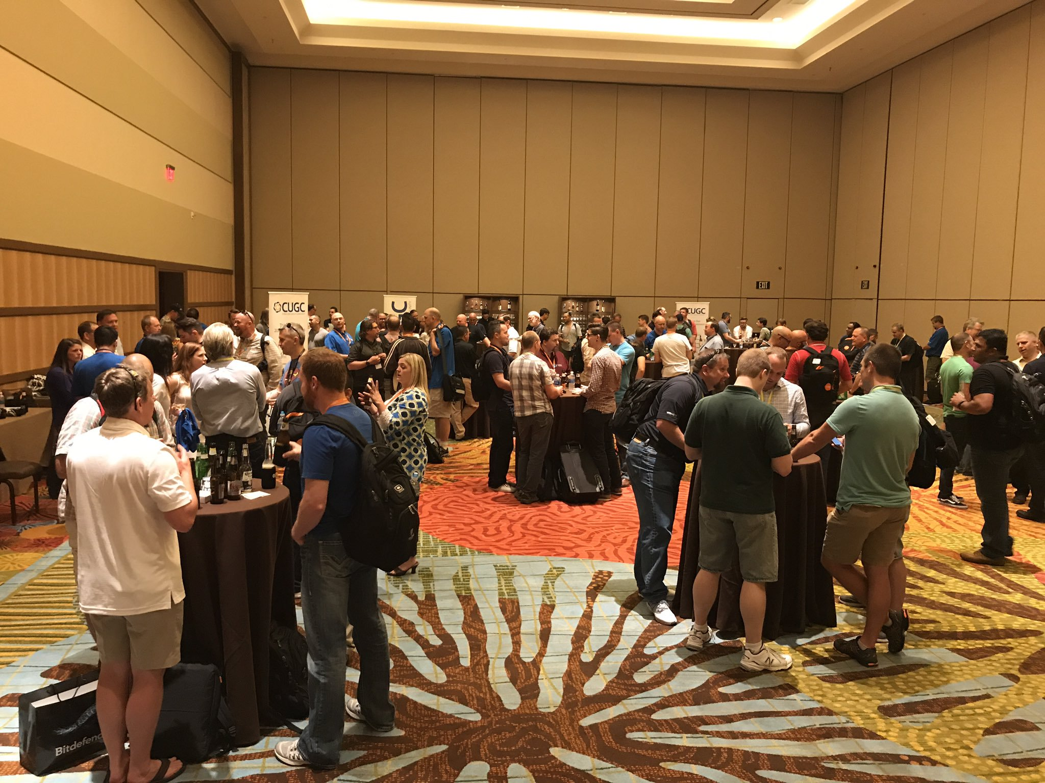
LEARN.
JOIN TODAY
SHARE.
WWW.MYCUGC.ORG
CONNECT.

Slide 2

EUC State of the Union 2023 Edition
#myCUGC
www.mycugc.org

Slide 3




Before we get started:
You will receive a link to today’s recording.
Submit your questions in the chat anytime!
Please fill out our anonymous survey at the end.
#myCUGC

Slide 4

Presenter:
Marius Sandbu
Cloud Evangelist @ Sopra Steria
Twitter @msandbu
Disclaimer: There is a bunch of stuff within EUC that happened last year that I didn’t fit into the agenda..(Sorry about that)
Also: Gonna be a lot of links find the PPT with content here → https://github.com/msandbu/mycugc
#myCUGC

Slide 5
Agenda
Introduction of AI and ChatGPT and how this will affect us
The current state of Microsoft/Citrix/VMware within EUC (with a hint of Broadcom and Cloud Software Group)
What's new with Azure Virtual Desktop, Windows 365 (and the new XenClient feature that is coming?)
Microsoft DevBox and EUC targeting Developers?
Hybrid deployments and support for AVD / VMware / CVAD and how to combine
Microsoft Azure AD-based devices
Updates to CVAD and new Cloud Services!
Updates to Public Cloud services (and other nifty license changes)
Zero-Trust based file storage service - Because OneDrive is not good enough...
Secure Private Access and where are with providing secure access without using crappy VPN software?

Slide 6
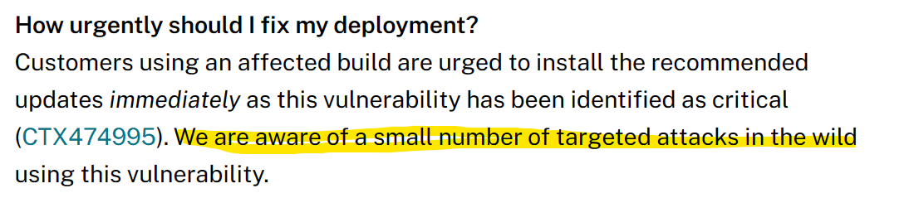
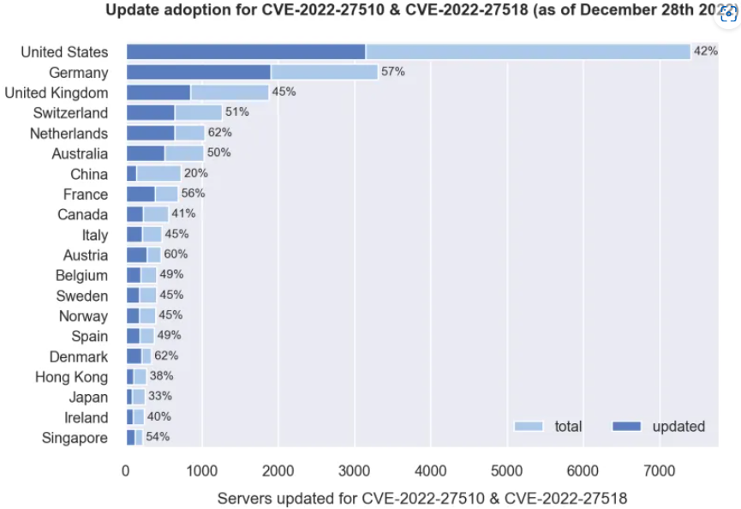
A Quick Security related update!
Citrix NetScaler Vulnerabilities
CVE-2022-27510 (Affecting Gateway Component)
CVE-2022-27518 (Affecting Gateway Component only if Gateway is configured as SAML SP or SAML iDP
More information: CVE-2022-27510, CVE-2022-27518 – Measuring Citrix ADC & Gateway version adoption on the Internet
End user

Slide 7
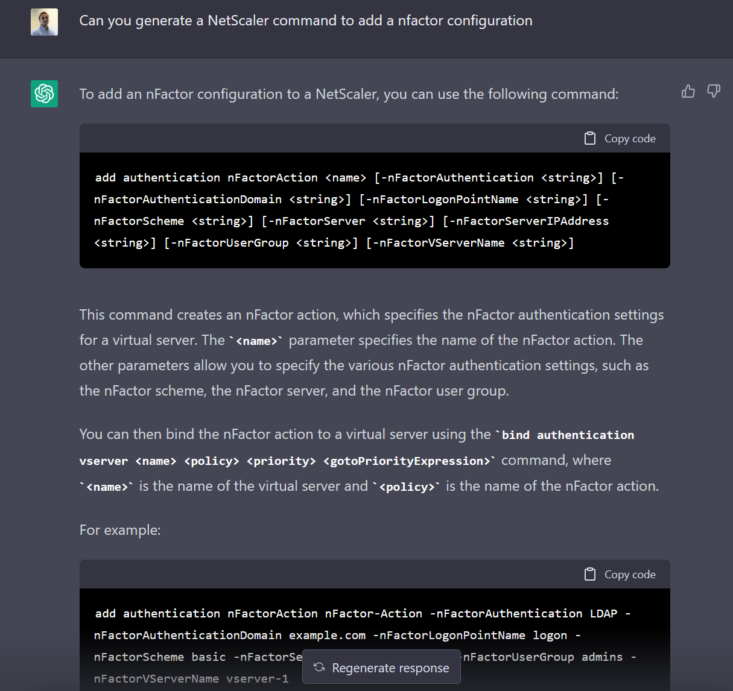

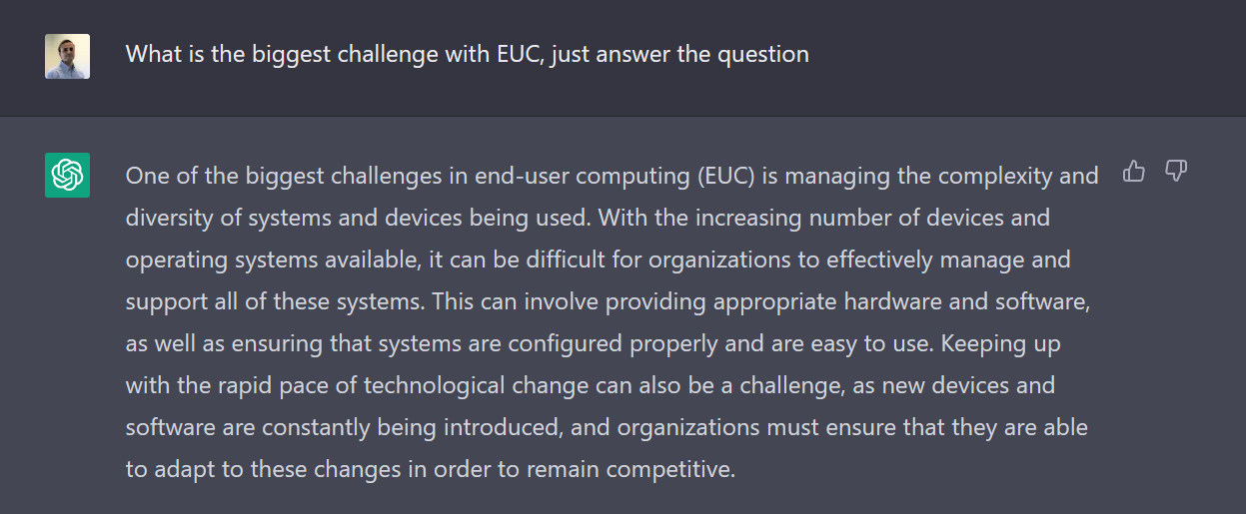
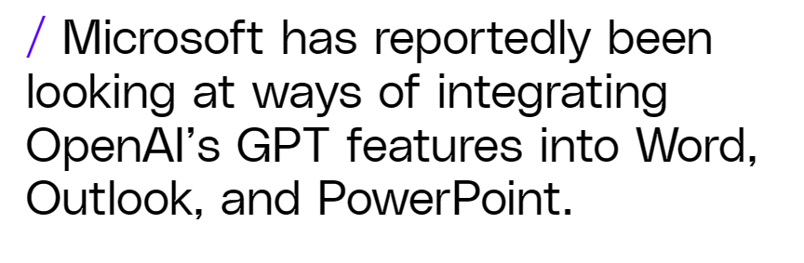

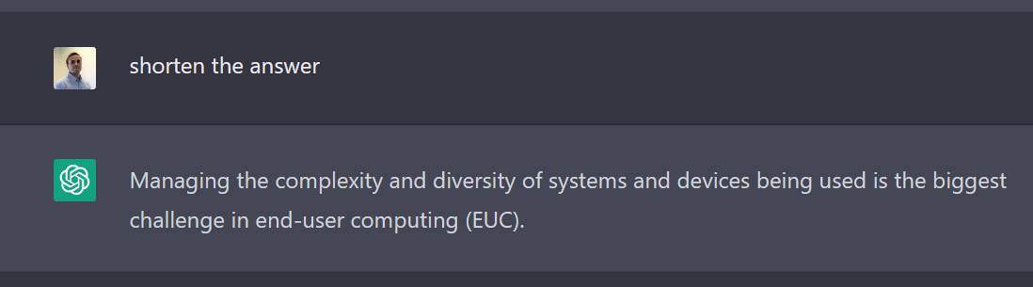
2022 – Are we seeing the rise of «true» AI?!
Not quite here yet....
End user
Still getting closer....

Slide 8
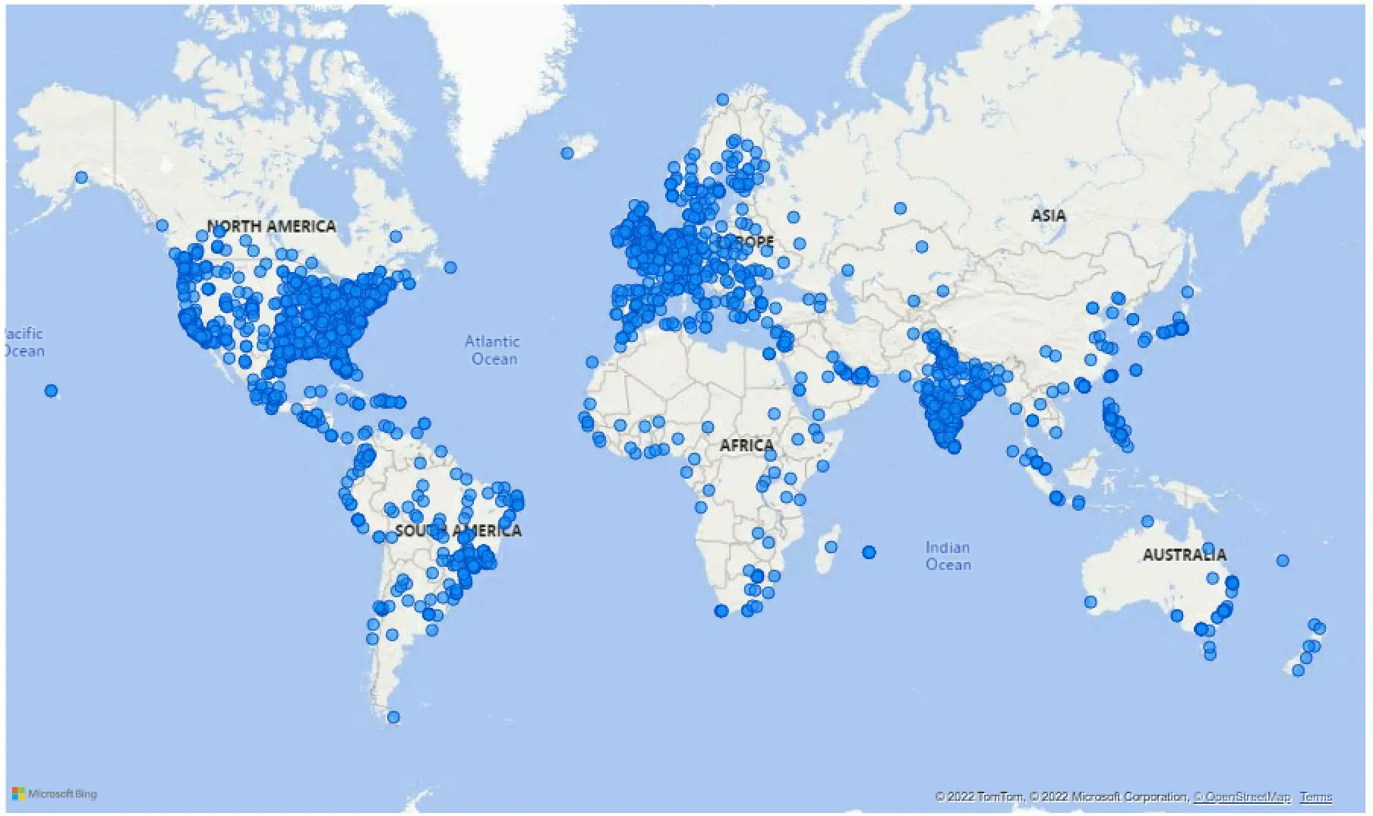
Current state of VMware / Citrix / Microsoft
Citrix: Old names (and products) are back!
XenServer, NetScaler, Sharefile (Did they really ever leave?)
Undos end-of-life for XenMobile and XenServer
Different business units within Cloud Software Group
How will collaboration and support work between them?
Ufortunately a sad day yesterday with many layoffs
VMware:
Aquired by Broadcom (don’t they make NICs?)
Given with Broadcom’s history with Symantec and CA it is going to be interesting
Still awating the EU approval
Citrix Gateway Service hosted 46 million user sessions in August
End user

Slide 9
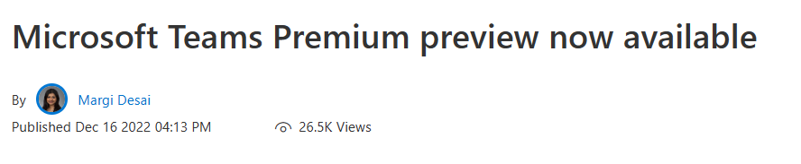
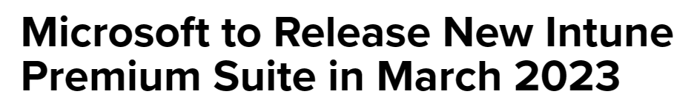
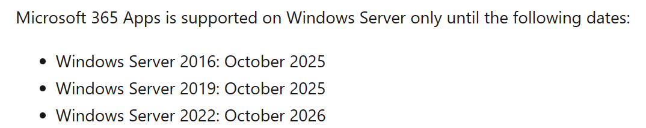
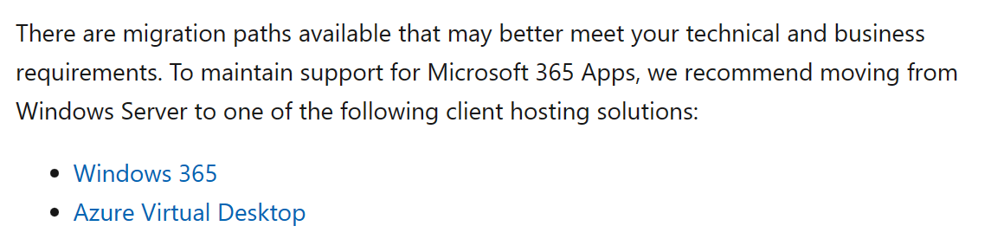
Current state of VMware / Citrix / Microsoft
Microsoft:
Still pushing out rapid changes
AVD and Windows 365 product teams under the same management in MS now
New SKUs and licenses!
Always trying to making Azure the more preferable option for Windows workloads
Microsoft Teams Shared Device licenses
New Product names!
Azure AD – Part of the Entra product family
Endpoint Manager – Intune

Slide 10
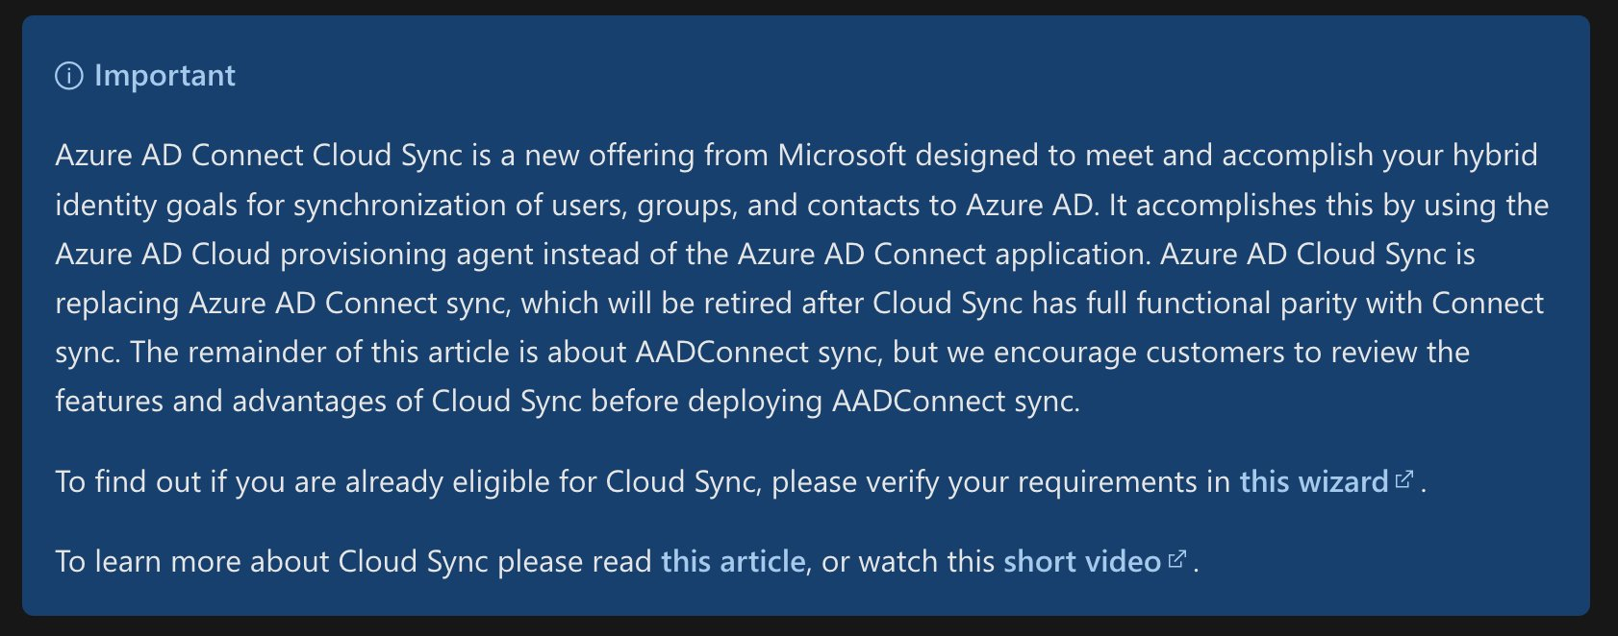
New with Azure Virtual Desktop & Windows 365
ShortPath for Public Networks GA (W365 and AVD)
UDP instead of TCP for Public Networks
No need to do any changes is enabled by default
Preview of SSO for Azure AD and Hybrid Joined Machines
Remember Kerberos Objects if Hybrid
Remeber enablerdsaadauth on host pools
FSLogix and Azure AD-Joined machines
Supports Azure Files with Azure AD Kerberos
Does not require line-of-sight to domain controllers
Remember that Azure AD Connect will be replaced by Cloud Sync
https://www.cloudpilot.no/blog/Deep-dive-Hybrid-Identity-using-Azure-AD-Connect-Cloud-Sync/

Slide 11
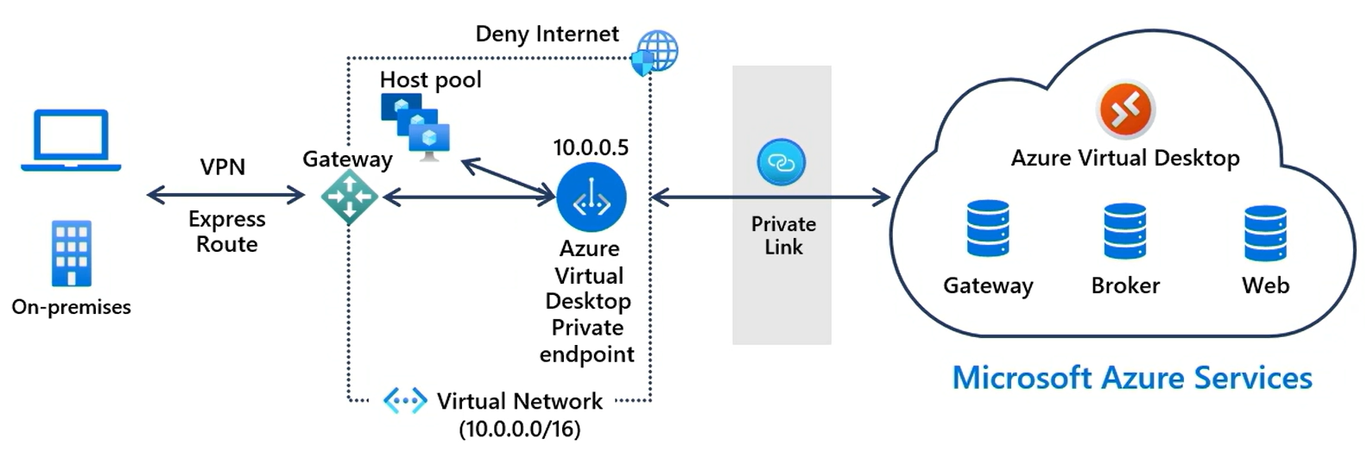
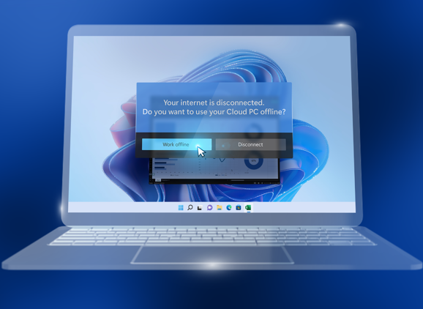
New with Azure Virtual Desktop & Windows 365
Private Link support
Scheduled agent update
New diagnostics information
Point in time restore for Windows 365
Coming with Offline Support
With Automatic Sync (What XenClient never had?!)
Also with Direct Windows 365 Boot
Very little done on the Protocol
RDP Protocol Specification Changes

Slide 12
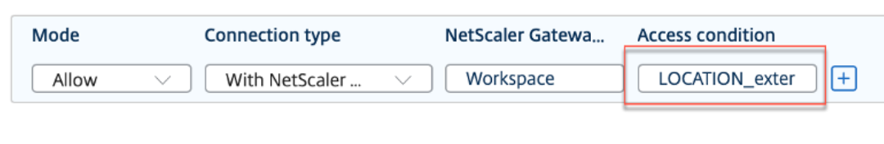
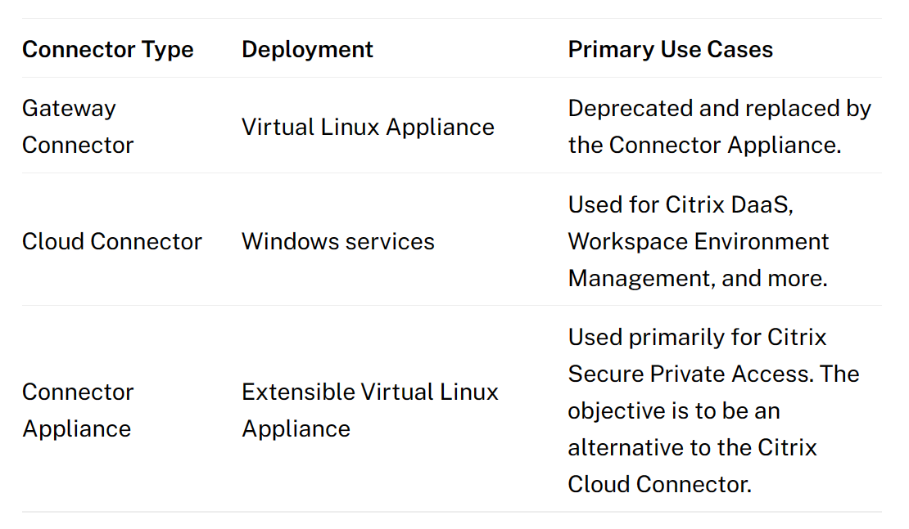
New with Citrix Cloud
Geolocation redirection
Provides smart access based upon location
Integration with Windows 365 with HDX Plus
Support for creating Azure AD Joined / Intune on master images
Support for Hibernation of Azure VM’s
Google Cloud Identity Support for Workspace
SAML Group-based authentication
AD support for Connector Appliance (Also Nutanix AHV)
Support to deliver MSIX and MSIX app attach applications

Slide 13
New with Citrix Cloud
Session Recording Service
Reduce footprint on-prem
Also support for Linux VDA
Citrix Enterprise Browser
Management trough Global App Config Service
Extension Management
Simplified SSO
Browser Content Redirection Chrome OS
Stronger Partnership with Google
Gateway Service on GCP PoP’s do not support EDT yet
Multi-Tenant Support in FAS
Still purely management and view - still need SQL server on-premises
Record number of malicious extensions in Chrome Store in 2022 😐
Citrix Cloud Updates | Multi-Tenant Support in FAS

Slide 14
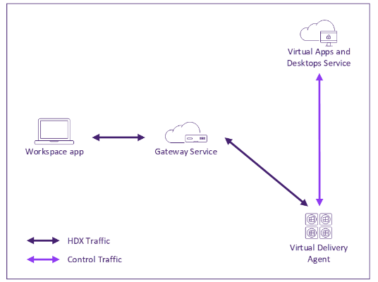
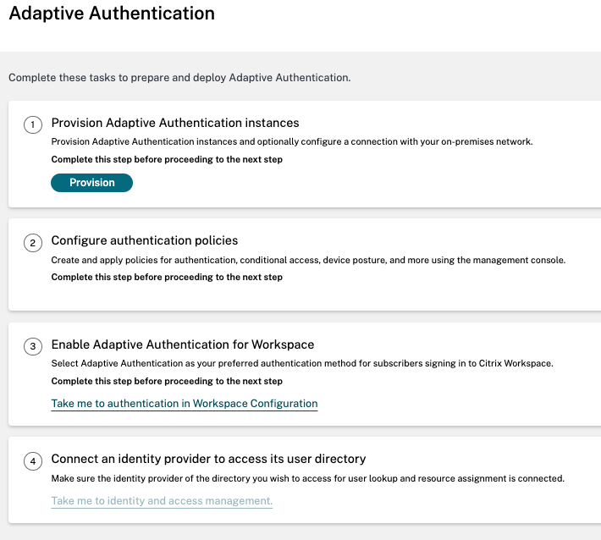
New with Citrix Cloud
Rendezvous (V2) Protocol
HTML5 and Microsoft Teams Optimization
Sharefile App for Microsoft Teams
Supports MCS on IBM Cloud (lol)
Azure AD Joined machines supported with Rendezvous (V2)
No need for Cloud Connectors or Appliances
Linux VDA and support for Azure AD authentication
Citrix Adaptive Authentication - Service
2x Cloud based NetScaler instances configured with Smart Access with EPA Scan and nFactor
Still need to navigate trough the NetScaler UI
Logs in Citrix Cloud (Logs stored for 90 days)

Slide 15
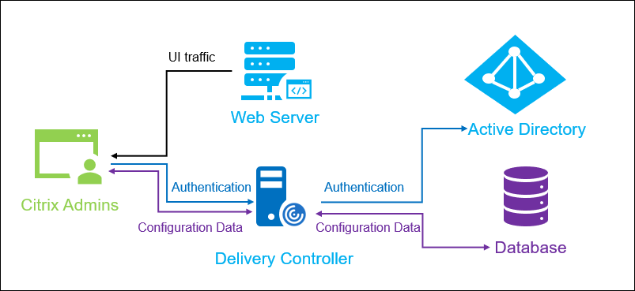
New with CVAD 2212 Release
Web based Studio on-premises
Support for delivering MSIX and App Attach using web management
This being the start on bridging the gap between Cloud and on-prem
Storefront will be revitalized as well

Slide 16
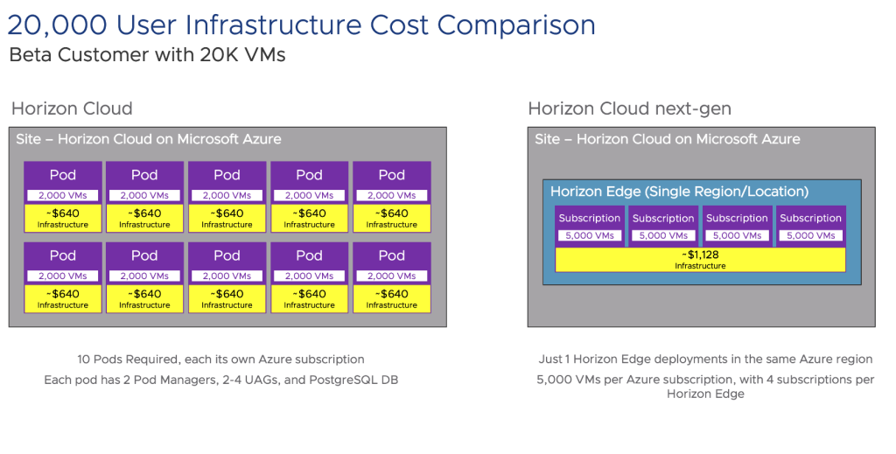
New VMware Horizon
Next-Gen Platform Available for Azure
AppVolumes App on Demand
Support for Amazon Workspaces Core
Workspace One suppport with multi-user mode for Azure AD based machines
More focus on insight into DEX
Announced support for Windows 365 (simliar to what Citrix has)

Slide 17
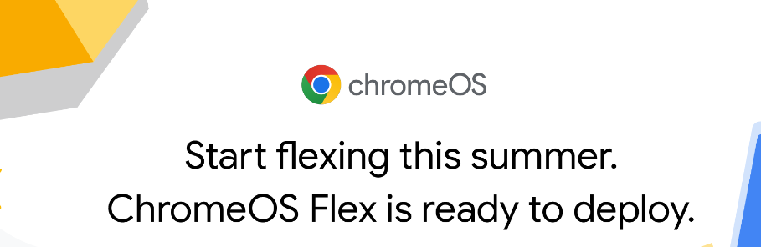
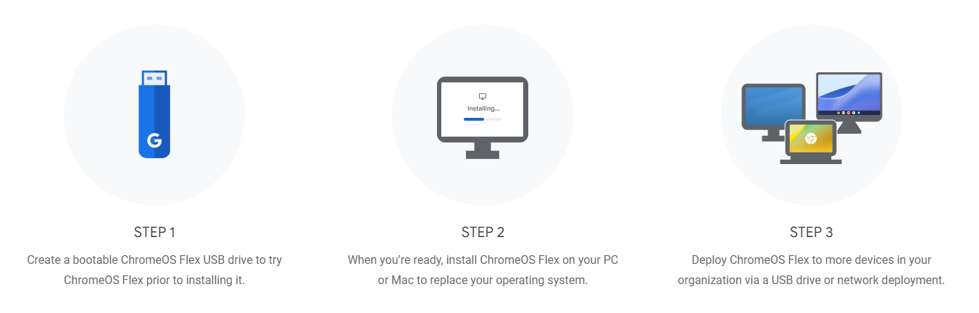
Other news!
Teradici remerged as HP Anywhere
Corel with Parallels aquires Awingu
Browser based access to internal services
Nerdio Manager supports Azure Stack HCI
Google released ChromeOS Flex
AWS announced Workspace Core
Predefined APIs for VDI providers
Also support for Ubuntu Desktops on Workspaces
Support for Zoom Optimization
Some great research on impact of optimizing Teams in VDI (AVD and Citrix)
Microsoft Teams optimization in a virtual desktop | GO-EUC

Slide 18
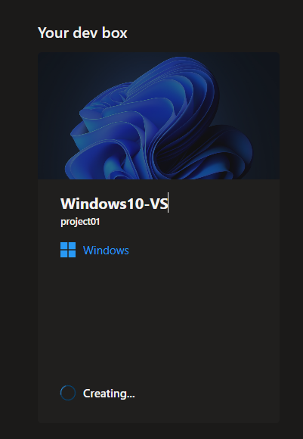
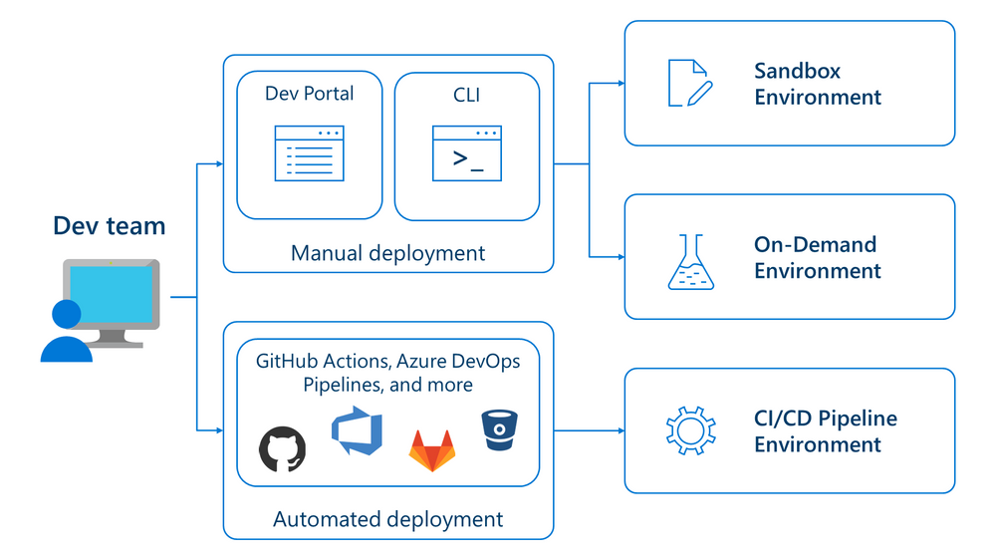
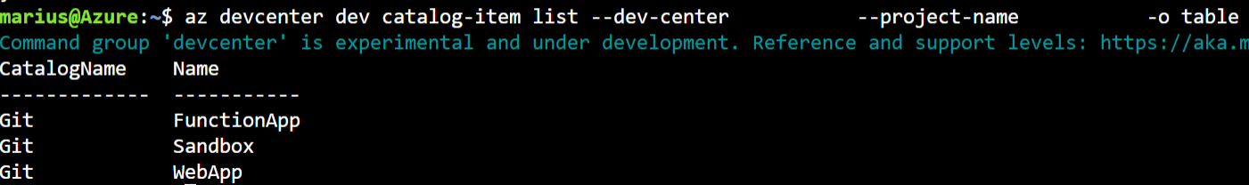
Azure DevBox and Deployment Enviroments
Provide more self-service capabilities to Developers
Think about a predefined template/blueprint
DevBox = Virtual Machines like Windows 365
Available trough a custom web portal
Deployment Enviroments = Everything else in Azure
Currently only available trough the Azure CLI

Slide 19
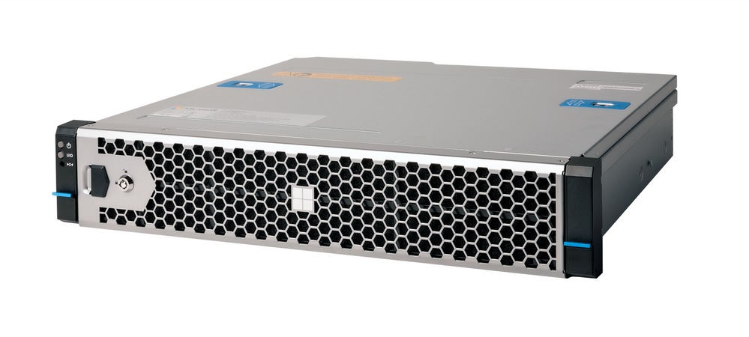
Hybrid support with VDI capabilities?
AVD supported only on Azure Stack HCI for Hybrid
Multisession support – Shortpath Support
Wierd support limitation – No technical limitation
Probably also coming to VMware as well (with Arc supported)
Microsoft coming with it’s own hardware in 2023
Citrix supports Azure Stack HCI (trough SCVMM)
Support for GPU-P (Similiar to vGPU) on Azure Stack HCI
Citrix - Introduced support for again Public Cloud (in 2212)
For those with Hybrid Rights Cloud Subscriptions

Slide 20
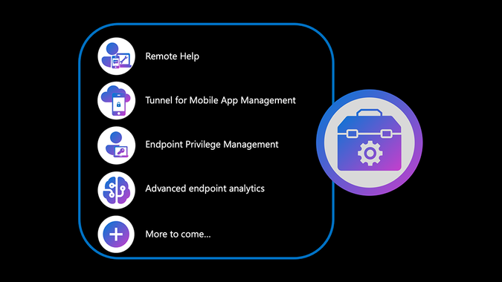
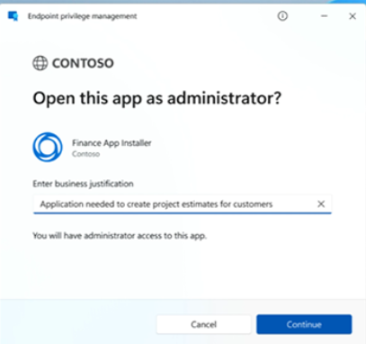
Intune and Windows what’s new?
Intune the new name....
New SKU (Advanced Management Suite) in 2023
Support for Linux and ChromeOS
Microsoft Teams Progressive web app for Linux
Remote Help integration with Service Now and Android
Privileged Identity Management built into the OS
Microsoft Tunnel for MAM
Import custom ADMX/ADML templates to Intune
Windows AutoPatch (Windows, Office and Edge)
If you trust Microsoft and all...

Slide 21
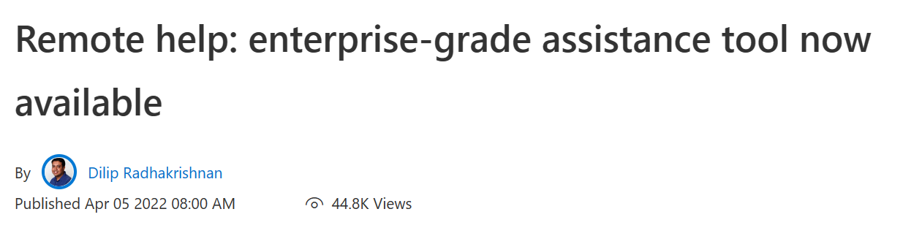
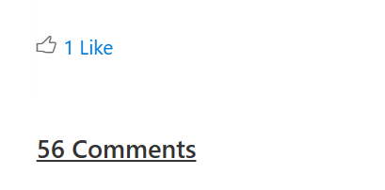
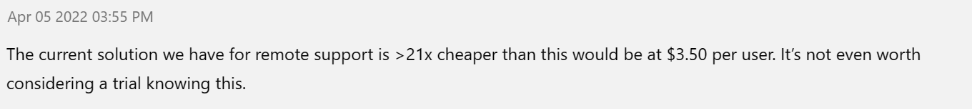
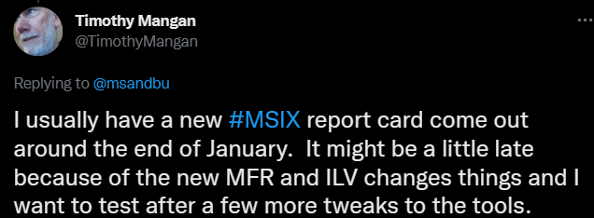
Intune and Windows what’s new?
Smart App Control
PDE (Personal Data Encryption)
For encryption individual files and content
Remote Help – Intune
Free for Educational
3,5$ Per user per month for Enterprise
Is MSIX now a viable alternative to App-V?
2022 Scorecard - MSIX_Report_Card_21H2

Slide 22
Azure AD Updates in 2022
Group Write Back in Azure AD
Entra Permissions Management (Cloudknox)
Workload Identity
FIDO2 Azure MFA Verification
Cross tenant federations and Teams Shared Channel
Improved Identity Flow with Logic App and Entitlement Managemnet
Nested group membership
Secure authentication with temporary pass
Continous Access Evaluation
Basic authentication from Exchange Online removed now in January 2023
Custom attributes for access Control
Certificate based authentication in Azure AD
Cloud Trust (GA)
Configure Lifetime of Access Token in Azure AD
Automatisk removal of inactive user accounts using access review
Marketing here decided to change all the names.....
On-prem user provisioning (LDAP and SQL)
Lifecycle Workflows
Azure AD Kerberos

Slide 23
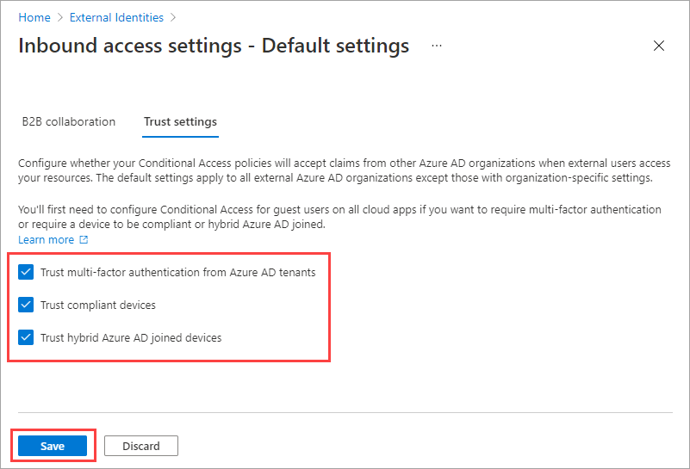
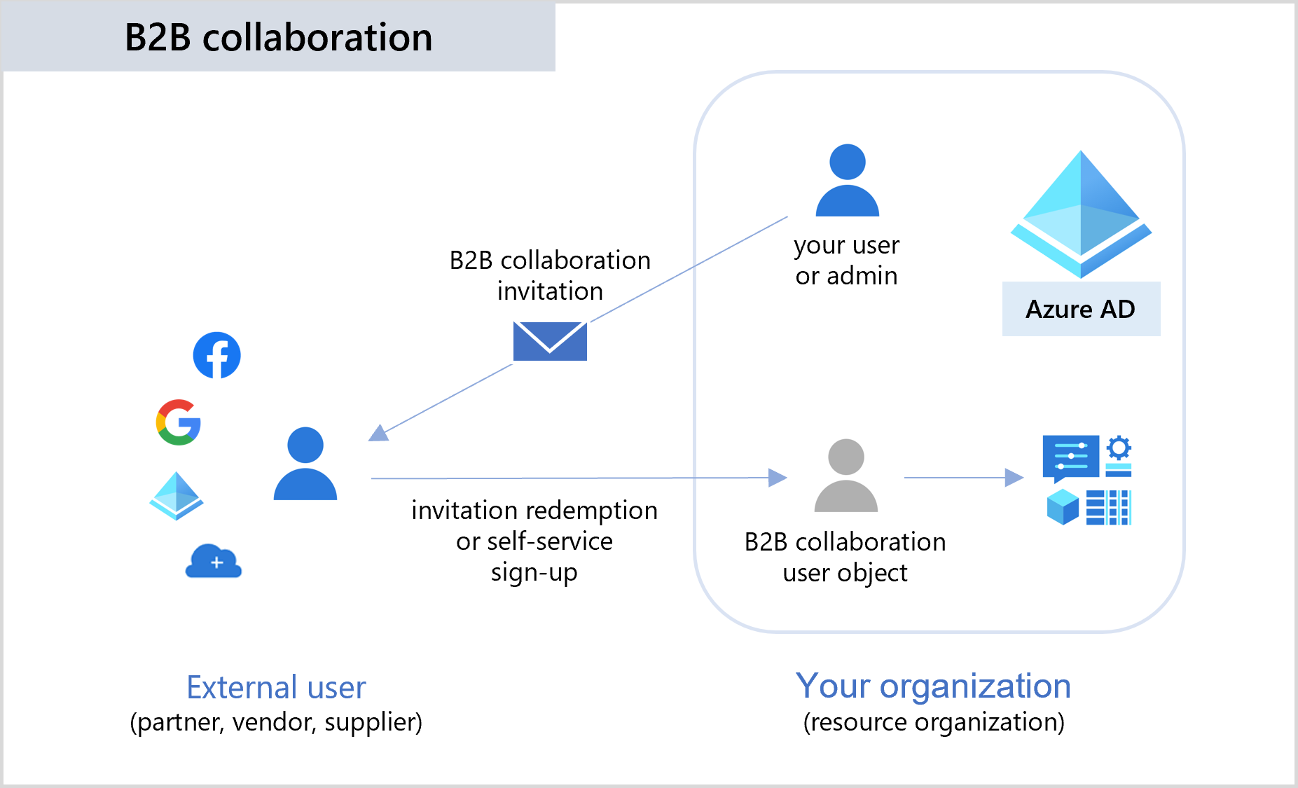
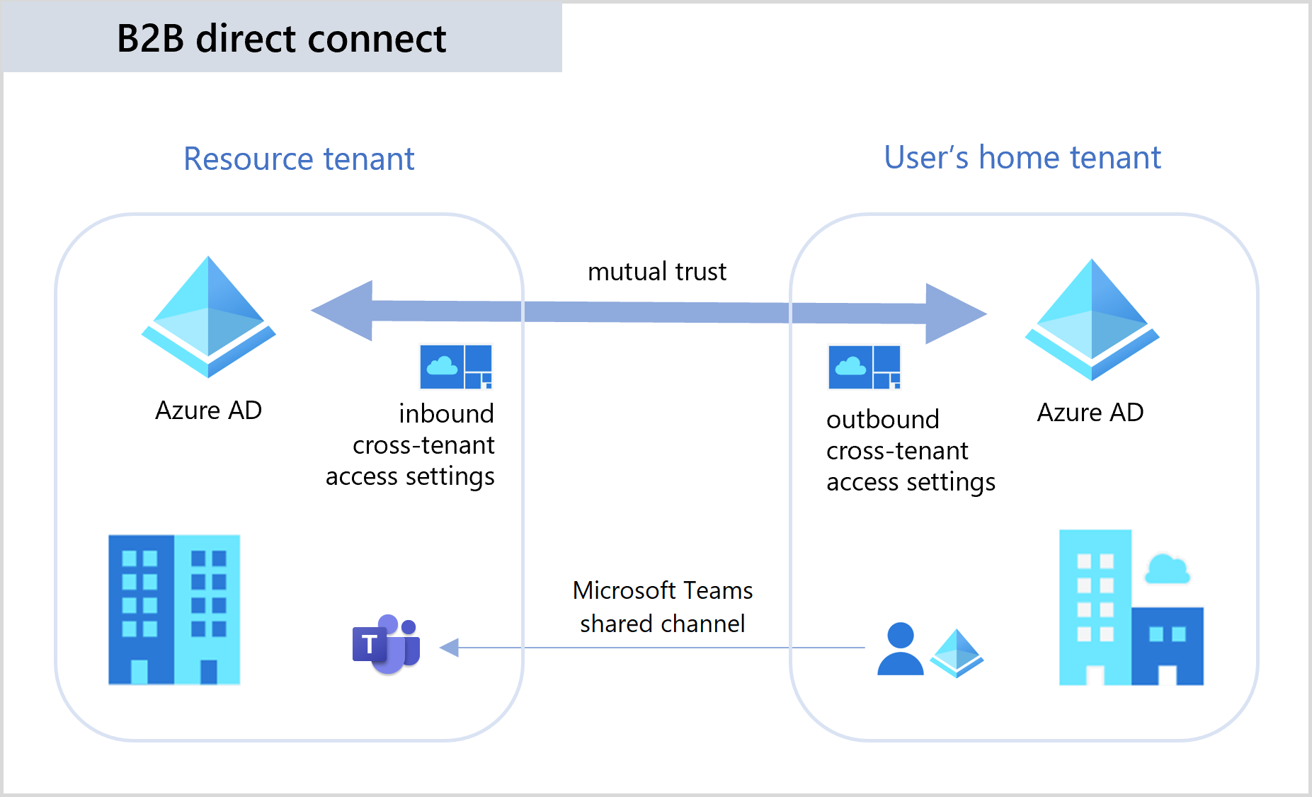
Teams Shared Channels and Azure AD B2B

Slide 24
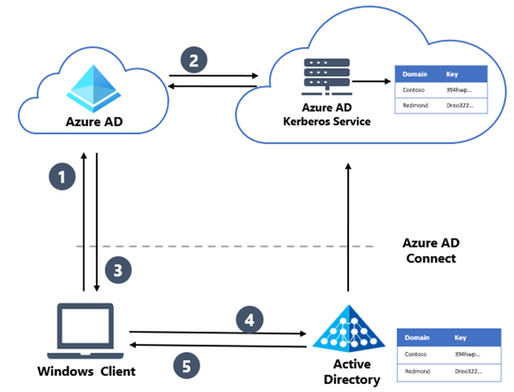
Hybrid Cloud Kerberos Trust
Uses Azure AD Kerberos
Simpler hybrid setup without the need for PKI services
Allows Azure AD Joined devices to have SSO to on-premises workloads
Does not support RDP / VDI
Does not support Run-as commands
Required Windows Hello enabled
Hybrid clients require initial line-of-sight to DC

Slide 25
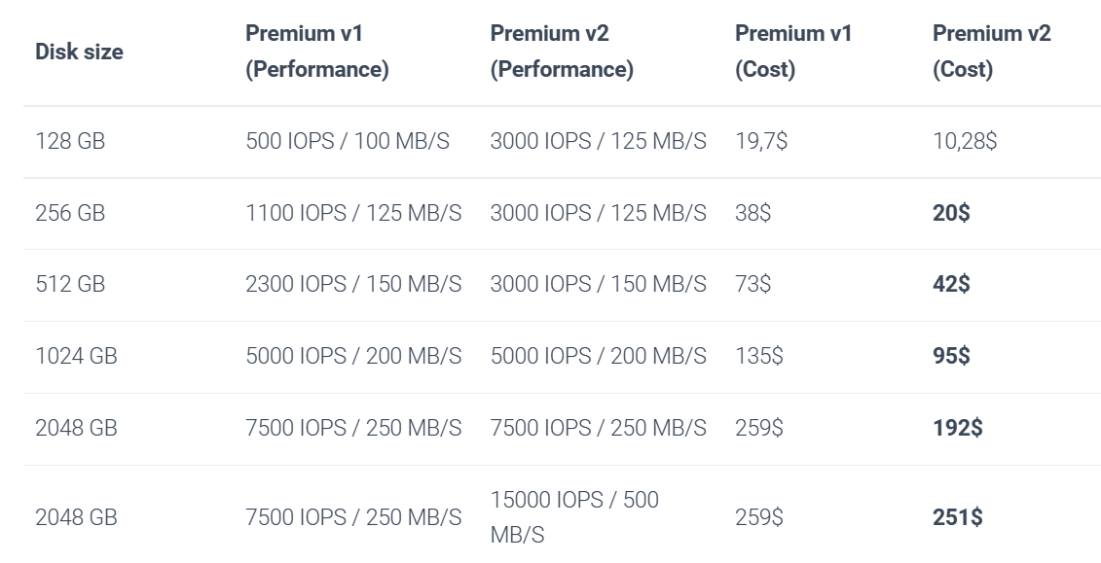
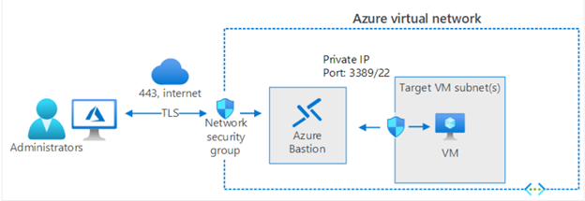
Other «nifty» related Azure and Azure AD updates
Storage V2 Disks and higher performance
Only for data disks at the moment
Elastic SAN
Back to iSCSI services
Cheaper storage trough for instance File Cluster
Nutanix Clusters available in Azure (US Only)
Confidental Computing
Windows Admin Center (Supported using Arc)
Azure Bastion
Azure P2S Group based access
NV5 A10 GPU machines (NVIDIA A10) now GA
Still quite limited quotas…

Slide 26
ZTNA (Zero-Trust Network access)
Never Trust - Always Verify
Identity Posture
Device Posture
ZTNA Magic
SaaS
TCP/UDP
Web Apps
Windows Apps
File Storage
Jumphost
End-user
Condition based access
Location
Time
Data
Session

Slide 27
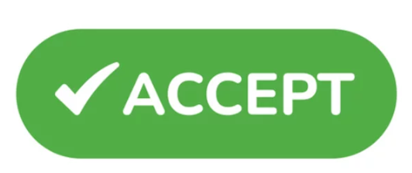
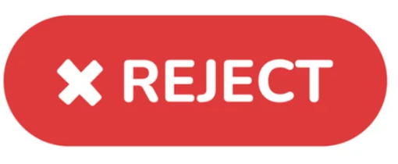
ZTNA – Secure Access without VPN??
Authenticate
MFA
User/Group access
Check Identity
Location/Network
ZTNA Magic
User – Bob (not in HR)
Device Posture
Antivirus
EDR
Session and data
Accessing data at 02 AM?
Download bunch of file from HR folders?

Slide 28
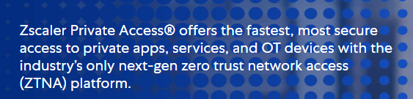
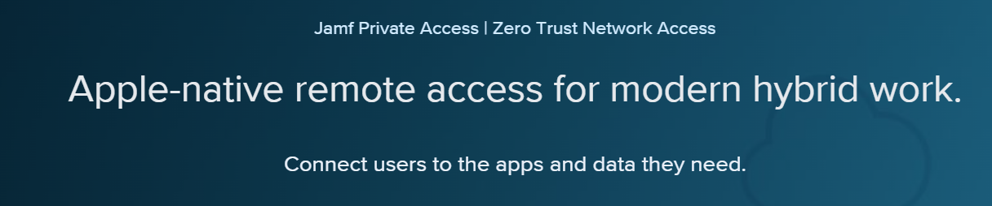
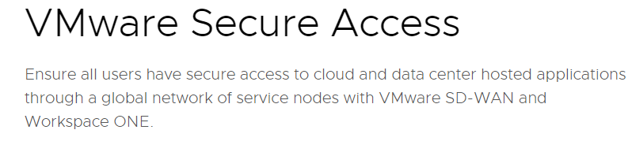
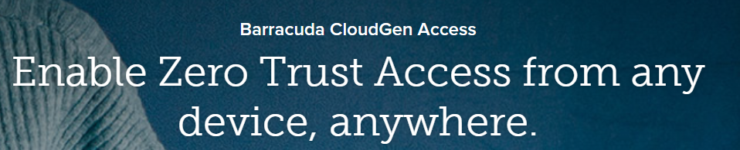
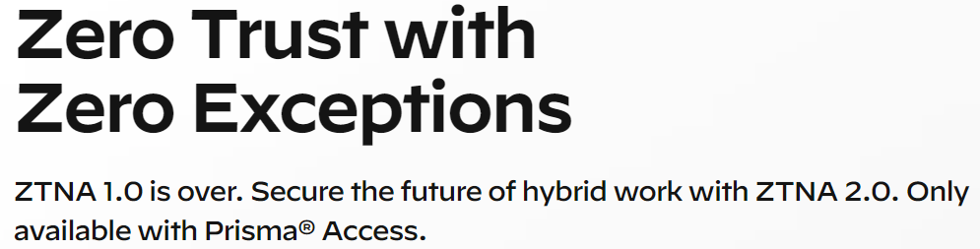
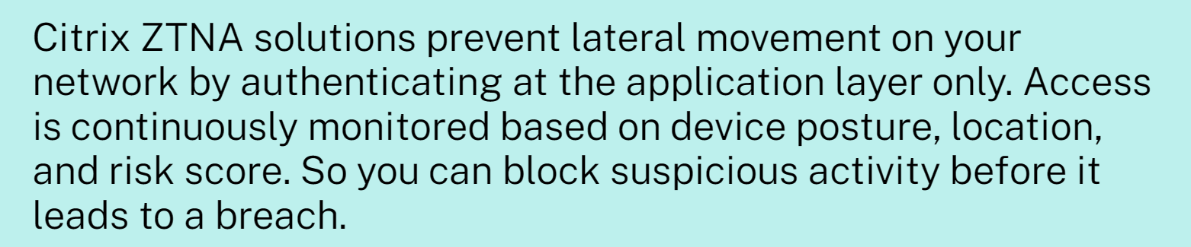
ZTNA – What options do we have?
Apparently, everyone....

Slide 29
ZTNA with Microsoft
Azure Active Directory
Azure AD SaaS apps
SaaS
Azure Bastion
Jumphost
Azure Application Proxy
Intern Web
Azure Virtual Desktop / W365
VDI
Conditional Access
Azure VPN with Azure AD
TCP/UDP
Intune & Defender
Azure Arc
SSH/K8s
Microsoft Tunnel
TCP/UDP

Slide 30
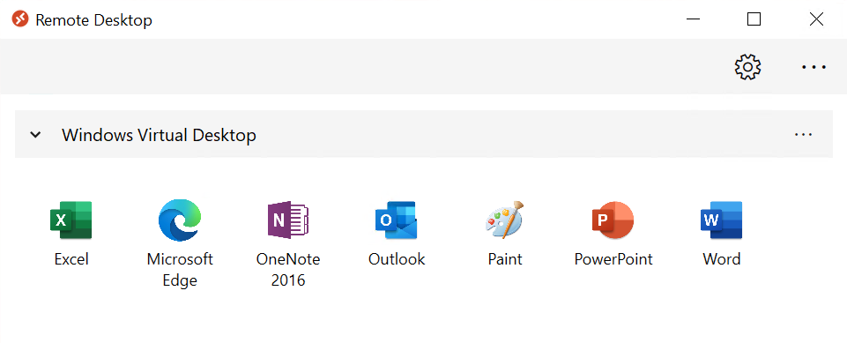



So...what would it look like for the users?
VDI
TCP/UDP
Jumphost
SaaS
Internal Web

Slide 31

Citrix Secure Private Access
SaaS
Many IDP’s
Connector Appliance
Internal Web
TCP/UDP
Citrix Cloud
Jumphost
Citrix Cloud Connector
Device Context from Secure Access Client
VDI

Slide 32
Citrix Secure Private Access
Supports most iDP’s
Supports native device context check
However, with their own client
NetScaler Gateway Plug-in (err I mean that Secure Private Access Agent)
Provides SSO across the whole stack
Single Agent & UI for most services

Slide 33
Cloudflare Zero-Trust
Many idP’s
Internal Web
Magic Tunnel
Warp
Cloudflared
TCP/UDP
Jumphost
Many EDR services

Slide 34
Cloudflare Zero-Trust
Supports most iDP’s
Supports a lot of EDR services
Uses Wireguard for tunnel traffic
Traffic routed trough Cloudflare
Uses QUIC as Transport
Supports TCP/UDP
Setup is kinda “funky”
Remote Browser Isolation & CASB in the making

Slide 35
What about Azure AD Devices and Local Storage?
Services | Integration / Access | Authentication | Data location
Avepoint Cloud Index | Integration between SharePoint and SMB file shares | Azure AD | On-prem
Azure Blob Storage | Azure Data Explorer | Access Key | Azure
Azure Files | Mount using SMB | Active Directory / Azure AD Kerberos | Azure
Azure NetApp Files | Mount using SMB | Active Directory | Azure
Fileflex | Mount using Web/SMB | Azure AD / Active Directory | On-prem
Nasuni | Mount using SMB (uses Blob Storage) | Active Directory | Azure
HubStor | Mount using Web | Azure AD | Azure
Egnyte | Mount using Web or Desktop App | Azure AD (SAML) | On-prem
NextCloud | Mount using Web or SMB | Active Directory | On-prem
MyWorkDrive | Mount using Web or SMB | Azure AD | On-Prem
Or you can use SMB over QUIC (SMB over HTTPS) in Server 2022 Azure Edition with Hybrid Trust
You can of course Sharefile, but that was not part of our evaluation

Slide 36
The solution we ended up with
Azure AD
SaaS
Azure AD Endpoints
Internal Web
AVD & Bastion
Jumphost
VDI
Conditional Access
Cloudflare Access
TCP/UDP
Intune & Defender
SSH/K8s
Egnyte
File
Canon Uniflow
Print

Slide 37
What does 2023 hold for EUC?
Citrix - Will continue to focus on multi-cloud strategy - Google important part
Why? They need more feet to stand on – Hybrid and other «clouds»
VMware - Focus on expanding into Digital Experience - while betting more on Azure
Why? Because Microsoft VDI Workloads will be mostly done on Azure for Cloud
Microsoft - Nothing revolutionary - their focus is on pushing workloads on Azure
Why? VDI is a Compute Intensiv workload which means more workloads
They do not have a good overall strategy related to EUC still fragmented – Hopefully that changes.
In the Nordics more adoption of AVD compared to 3.party
Remote Access is more then VPN and VDI - more focus on DEX
Is 2023 the year of the developers and VDI - I think so

Slide 38

Other questions?
Access PPT Slides →
github.com/msandbu/mycugc
@msandbu
msandbu@gmail.com
THANK YOU!
www.mycugc.org
#myCUGC

